Slide 1
Energy debate bracket

Slide 2
A-day
Solar (PV)
Beth
Wil
Kaylyn
Casey
Solar (conc)
Luke
Daniel
Emily
Caleb
Wind
Anthony B
Anthony L
Michelle
Irene
Coal (traditional)
Jack
Dana
Lindley
Kelly
Coal (CCS)
Thomas
Quin
Nella
Nuclear
Maiya
Ben
Matthew Sc
Geothermal
Branson
Brandon
Matthew Se
Hydro
Sydney
Anna
Stephen
Nat Gas
Fana
Austin
Paige
Biomass
Oliver
Evan
Jenny

Slide 3
B-day
Solar (PV)
Allison
Heng
Mikayla
Gena
Solar (conc.)
Sierra
Esperanza
Connor
Wind
Nathaniel
Addie
Liz
Coal (traditional)
Robin
Lucas del R
Brian
Coal (CCS)
Park
Finn
Chandler
Nuclear
Mücïs
Gray
Dasia
Geothermal
Alana
Sean
John
Hydro
Cyrus
Kenny
Maya
Nat Gas
Anjili
Lyse
Guadalupe
Biomass
Zhan
Xavier
Luis

Slide 4
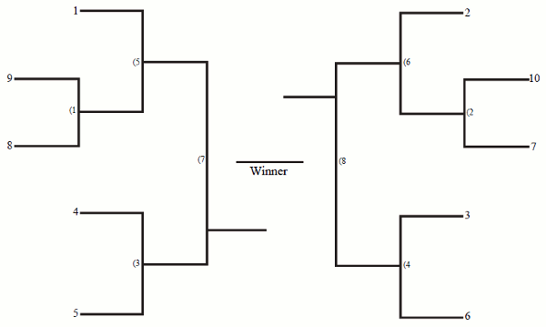
A-day
Solar (conc)
Nuclear
Solar PV
Coal (trad)
Biomass
Hydro
Geothermal
Coal (CCS)
Wind
Nat Gas

Slide 5
B-day
Solar (conc)
Nuclear
Solar PV
Coal (trad)
Biomass
Hydro
Geothermal
Coal (CCS)
Wind
Nat Gas

